Slide 1
Chapter 14
Persuasive Speaking

Slide 2
Why Persuade?
Why are people often uncomfortable about the word “persuasion?”
Informative vs. Persuasive Speaking
Information + Change = Persuasion

Slide 3
Persuasion Defined
Persuasion can be defined two ways for two purposes
The first is “the process of creating, reinforcing, or changing people’s beliefs or actions” (Lucas, 2015).
Think of persuasion as a continuum or line going both directions
Examples and considerations…

Slide 4
Persuasion Defined
The second definition of persuasion pays attention to ethics…
“A symbolic process in which communicators try to convince other people to change their attitudes or behavior regarding an issue through the transmission of a message, in an atmosphere of free choice” (Perloff, 2003)
Persuasion is symbolic
Persuasion as an attempt
The Audience has free choice
The speaker tries to convince the audience to change
The audience is the ultimate judge

Slide 5
Why is Persuasion Hard?
People don’t like change
People go out of our way to protect our beliefs, attitudes, and values
The audience members are holding a mental dialogue with the speaker
Reasons not to change can be stronger than even very logical reasons to change

Slide 6
Why is Persuasion Hard?
Solutions to the Difficulty of Persuasion
Have reasonable persuasive goals
Deal with audience reservations
Two-Tailed Arguments
The audience must view the benefits of the change as worth the stress of the change

Slide 7
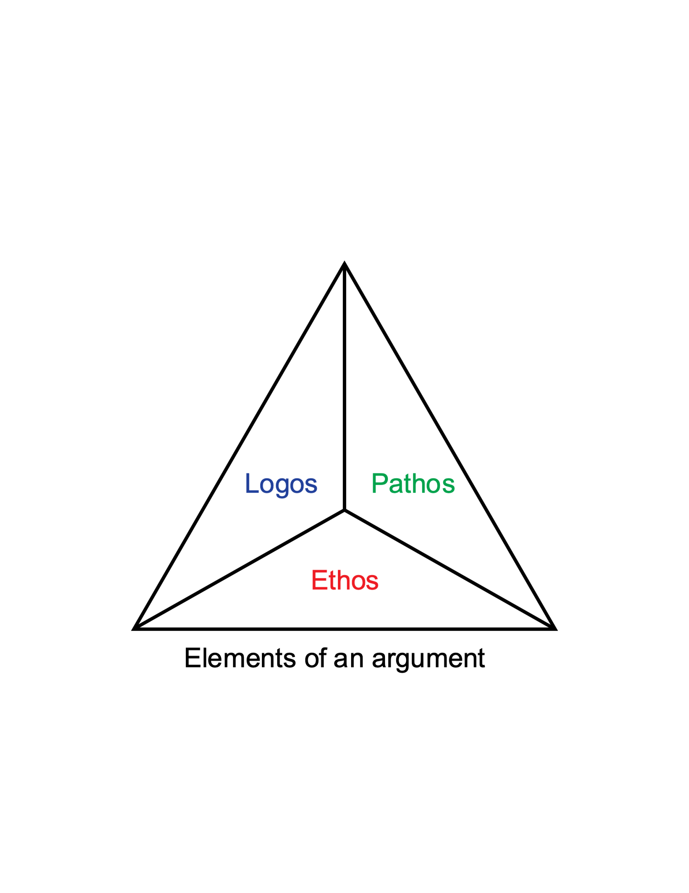
Traditional Views of Persuasion
Ethos
Pathos
Logos

Slide 8
Constructing a Persuasive Speech
This speech is the culmination of the skills you have learned already in this class
Formulating a proposition
Proposition of Fact
Propositions of Definition
Propositions of Value
Propositions of Policy

Slide 9
Constructing a Persuasive Speech
Monroe’s Motivated Sequence
Attention
Need
Satisfaction
Visualization
Action

Slide 10
Constructing a Persuasive Speech
Building Upon Your Arguments
Put your strongest last
Use evidence that is credible to your audience
Use evidence that is new to your audience
Use evidence that is relevant and in the proper context
Concluding Thoughts…
This is an opportunity to share your priorities
Select a topic that is aligns with your experience
Look for quality evidence
Craft a clear proposition
Enhance ethos, pathos, and logos

