Slide 1
Chapter 9
Delivery

Slide 2

The Importance of Delivery
Delivery and its relation to the fear of public speaking
The story of Bobby & Chris
Delivery is the root of most concerns about speaking in public

Slide 3
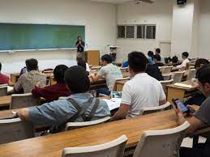
Methods of Delivery
Impromptu Speaking
  a short message without advance preparation
  Happens often and is typically informal
  Advantages & Disadvantages
Manuscript Speaking
  the word-for-word iteration of a written message
  speaker maintains his or her attention on the printed page except when using visual aids
  Advantages & Disadvantages

Slide 4
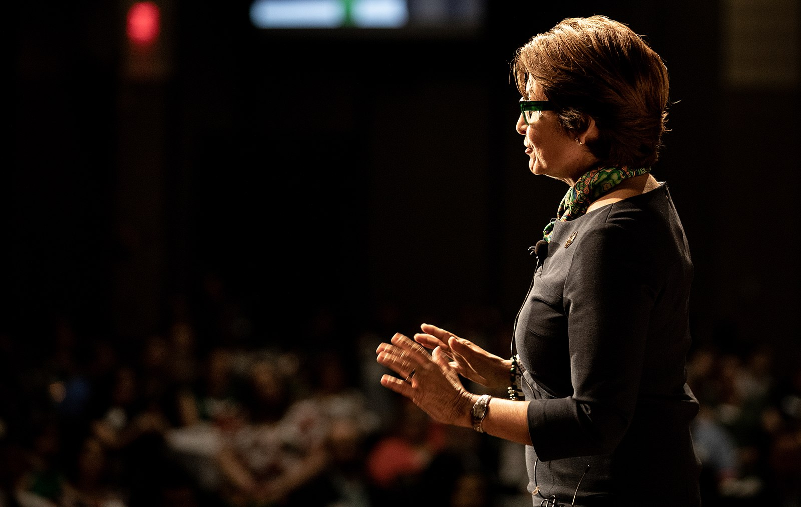
Methods of Delivery
Extemporaneous Speaking
  the presentation of a carefully planned and rehearsed speech, spoken in a conversational manner using brief notes
  Advantages & Disadvantages
Memorized Speaking
  the rote recitation of a written message that the speaker has committed to memory
  Advantages & Disadvantages

Slide 5

Preparing for Your Delivery
Using Lecterns
Indoor Space Size
Outdoor Spaces
Using a Microphone
Audience Size

Slide 6
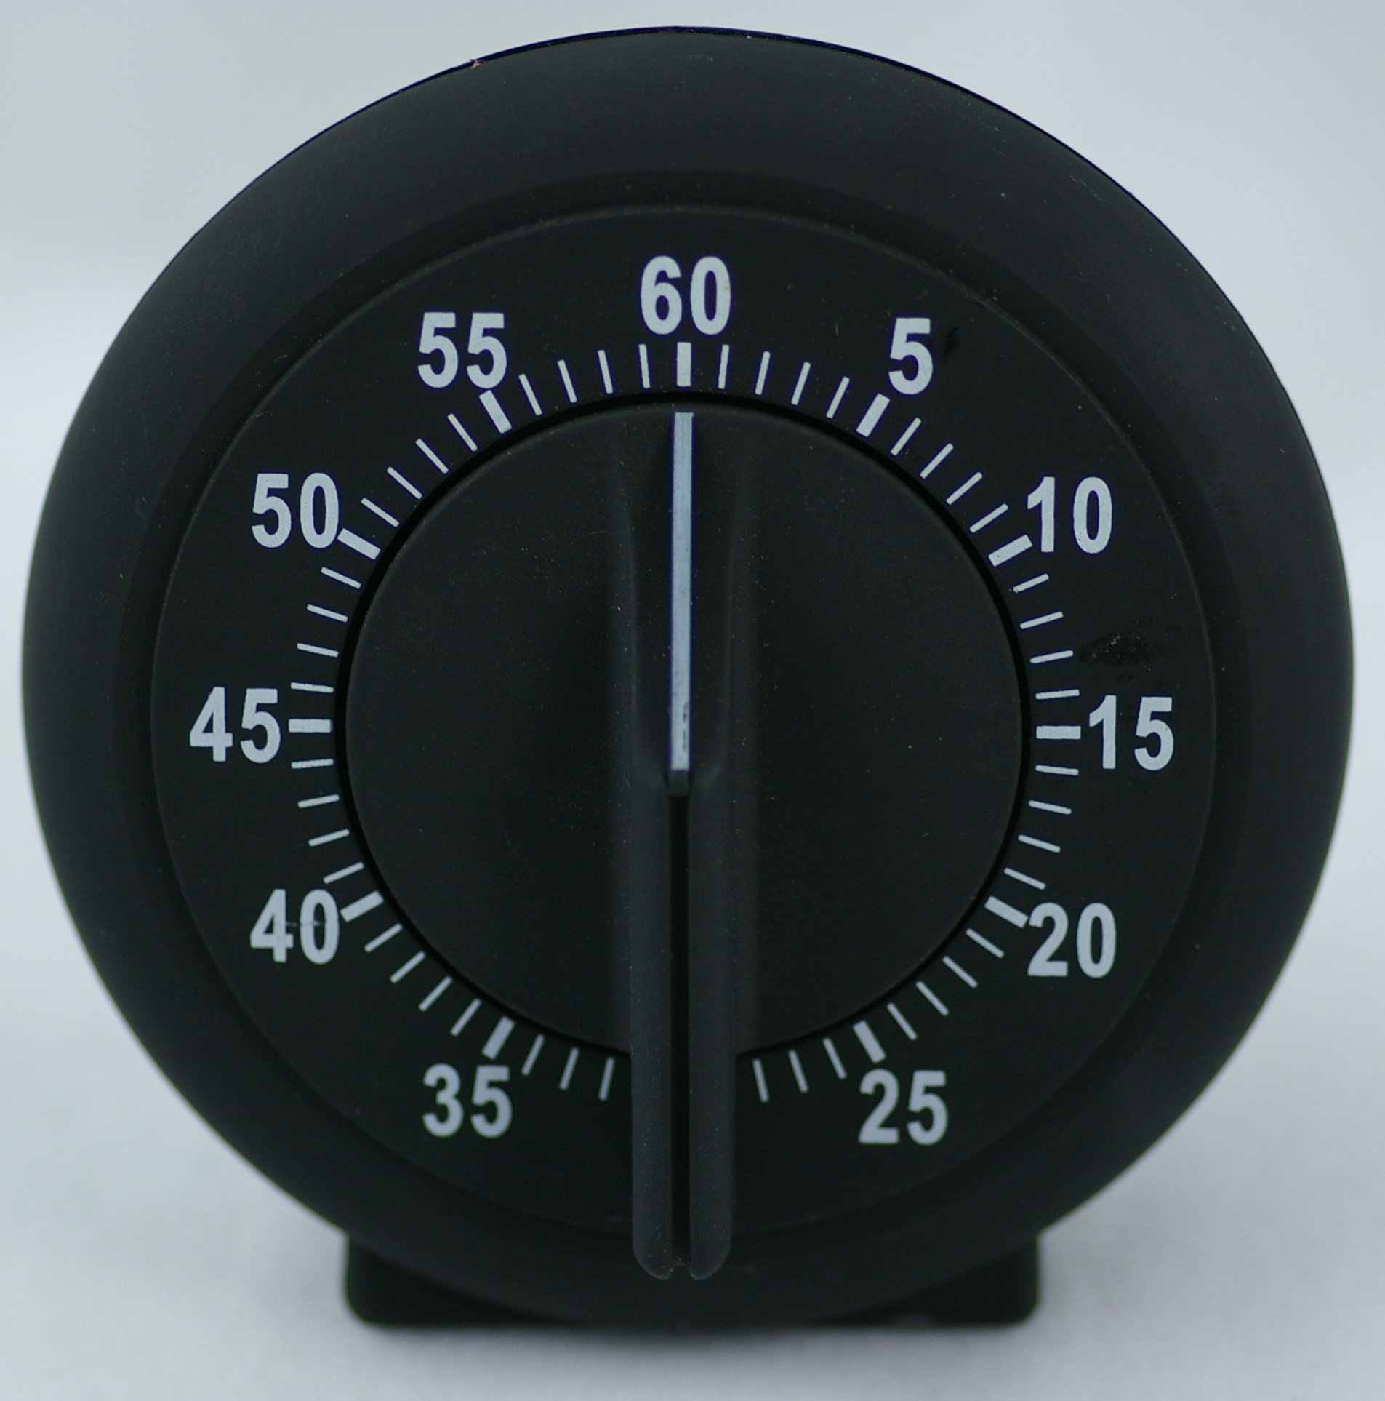
Practicing Your Delivery
There is no “one size fits all” delivery plan
Practice
  Out Loud
  Standing Up
  With a Lectern
  With an Audience
  While Keeping Time
  By Recording Yourself

Slide 7

What to do When Delivering Your Speech
Verbal & Nonverbal Elements
  Hands
  Feet
  Objects
  The Lectern & Posture
  Eye Contact

Slide 8
What to do When Delivering Your Speech
Vocal Considerations
  Volume
  Pitch
  Rate
  Pauses
  Vocalized Pauses

Slide 9

Expert Advice on Delivery
What does Mr. Chad Daniel, Lecturer in Theatre at Dalton State College say about delivery?
Overall, Good delivery is meant to augment your speech and help convey your information to the audience

