Slide 1
Chapter 11
Language

Slide 2
What Language Is and Does
Language is any formal system of gestures, signs, sounds, and symbols used or conceived as a means
of communicating thought, either through written, enacted, or spoken means
The study of language is controversial

Slide 3
What Language Is and Does
Connotative vs. Denotative Meaning
Language is abstract
Words change meaning over time, or more specifically, the meaning we attached to them changes

Slide 4
What Language Is and Does
Can you think of how advertisers choose words in a way that is meant to affect your thinking and see an object in different ways?

Slide 5
Standards for Language in Public
Good communicators strive for clarity
How do we achieve clarity?
Concreteness is clarity
Literal vs. Figurative Language
Similes and Metaphors
Cliches

Slide 6
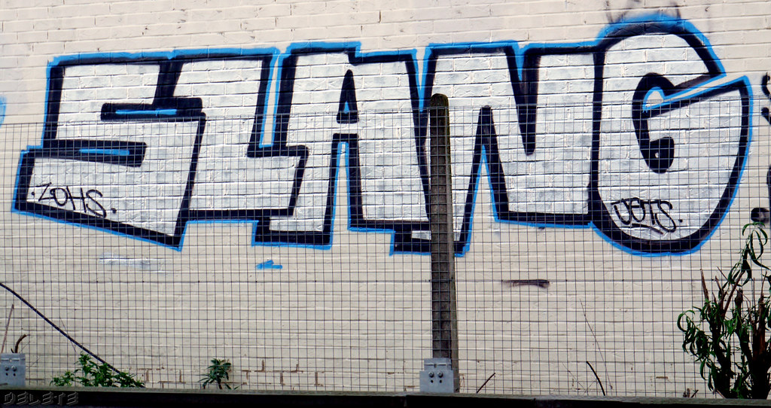
Standards for Language in Public
Language achieves effectiveness by communicating the right message to the audience. Clarity contributes to effectiveness, but there are some other aspects of effectiveness.
Jargon
Slang
Vocabulary
Profanity

Slide 7
Standards for Language in Public
Language should enhance your credibility
Rhetorical Techniques
Assonance
Alliteration
Antithesis
Parallelism
Anaphora
Hyperbole
Irony

Slide 8
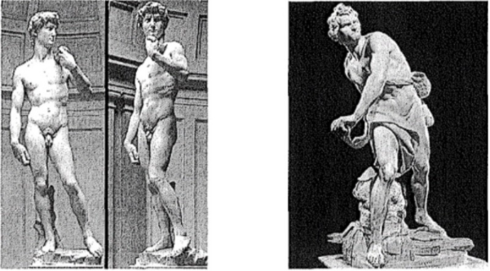
Standards for Language in Public
Language must be appropriate
Gender Inclusive Language
Ethnic Identity
Disability
Language in a speech should be appropriate to the speaker and the speaker’s background and personality, to the context, to the audience, and to the topic.

Slide 9
Using Effective Language in Public Speaking
Here are some applications and suggestions to help you grow as a public speaker:
Get in the habit of using “stipulated definitions” with concrete examples
Develop specific language
Personalize your language
Develop your vocabulary, but don’t show it off

