Slide 1
Chapter 8
Organizing and Outlining

Slide 2
Introduction to Organizing and Outlining
Steps to creating a rhetorical masterpiece:
Selecting a topic appropriate to the General Purpose
Deciding on a specific purpose of the speech
Creating a thesis statement (central idea)
Selecting the main points and organizing them
Let’s talk about creating a speech

Slide 3
The General Purpose
General purpose falls into one of three categories
Speaking to Inform: teach the audience about the topic, presenting facts
Speaking to Persuade: choose a side of a topic and advocate for that side
Speaking to Entertain: connecting the audience to the celebration

Slide 4
The Topic
Choosing a topic involves brainstorming the speakers interests and activities
There should be a connection between the speaker and the topic
Other considerations:
Time
Audience interest
Ability to find resources
Occasion and setting

Slide 5
The Specific Purpose
The specific purpose clearly states what the speech will achieve
A single sentence on what the audience will gain from the speech
The specific purpose is a combination of the General Purpose and the Topic
General Purpose: to inform
Topic: Blue Whales
Specific Purpose: To teach my audience about the family interactions of blue whales

Slide 6
The Thesis Statement
A single declarative statement that captures the main idea of the speech
Gives the audience a preview of what to expect from the speech

Slide 7
The Preview Statement
Previews the main points of the speech
The speaker states the upcoming main points with the goal of providing a path for the audience to follow in the speech

Slide 8
The Body of the Speech
3 – 4 Main points that support the thesis and help the audience to achieve the specific purpose
The opportunity to provide your supporting evidence and do the work outlined in the specific purpose

Slide 9
Organizing Patterns for an Informative Speech
Organizing is how the main points and information are presented to the audience
This section covers organizational patterns for Informative speeches and Persuasive Propositions of Fact speeches

Slide 10
Chronological Pattern
The main points are presented in time order
Shows the interconnectedness of the main points and follows the topic over time

Slide 11
Topical Pattern
Main points support the thesis, but the order of presentation isn’t important
Main points are there to prove or provide information about the thesis

Slide 12
Spatial Pattern
Arrange main points according to their physical or geographic relationships
Main points would be described as the spaces they are, giving the audience a visual image of the space

Slide 13
Causal Pattern
Explaining the cause of an event and the event that occurred, main points may be cause-cause-effect or effect-cause-cause
In an informative speech there is no judgement or discussion of whether this is good or bad, it is just an event

Slide 14
Outlining Your Speech
Outlines or textual arrangements are very common ways of organizing a speech before it is delivered
Helps the speaker see the main points as it relates to the thesis and how they correspond to each other

Slide 15
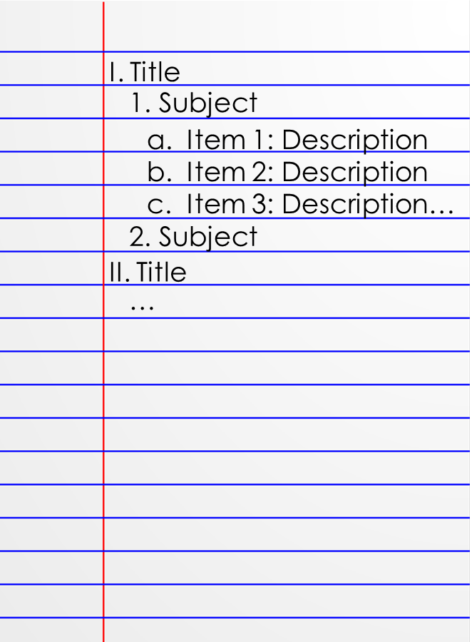
Preparation Outline
The outline that helps the speaker prepare their speech
The first outline created with initial ideas
Should include full sentences but not an essay of information
This Photo by Unknown Author is licensed under CC BY-SA-NC

Slide 16
Speaking Outline
Used when the speech is delivered
Brief words and phrases to remind the speaker of the points, supporting information and signposts
Could be on notecards, or paper

Slide 17
Components of an Outline
Main points
Main points support the thesis
Single declarative sentences
Main points are numbered with Roman numerals

Slide 18
Components of an Outline
Subordination and Coordination
Subpoints support the main points and are numbered under the previous point,
Coordination means that all the numbers or letters represent the same higher order idea
Parallelism – beginning each sentence in a similar way, using similar grammatical patterns
Division – Main points are divided into subpoints for support, there must be 2 supporting points minimum for each main point

Slide 19
Connecting your Main points
Transition statements are connectives that help move the audience through the speech
Each speech is a collection of main points, transitions help the audience know we have moved to a new main point
Signposts – word or short phrase that signals movement into another point such as “next” or “first”
Internal previews and summaries – provides a preview of what is coming or recaps what has been discussed, longer sentences
Example: “So far, we have seen that the pencil has a long and interesting history (internal summary). Now (signpost), we can look at how the pencil can be used” (internal preview)

