Slide 1
Chapter 5
Ethics

Slide 2
The Ethics Pyramid
Intent
Ethics begins with ethical intentions
As a speaker, intent means being honest with the information and position of the speaker
As a listener, intent means allowing the speaker to make their case before forming judgments
Plagiarism is unethically taking someone else’s words and passing them off as your own

Slide 3

The Ethics Pyramid
Means
The tools or behaviors we employ to achieve a desired outcome
Being ethical means choosing good means to achieve the desired end result

Slide 4
The Ethics Pyramid
Ends
The desired outcome
Means are the behavioral choices we make, Ends are the results of those choices
When thinking about the end, it is important to think about both the speaker and the listener

Slide 5
The Ethics Pyramid
3 Basic Questions to think about ethics:
  1. Have I discussed the ethicality of the behavior with others and come to a general consensus that the behavior is ethical?
  2. Does the behavior adhere to known codes of ethics?
  3. Would I be happy if the outcomes of the behavior were reversed and applied to me?

Slide 6

Ethics in Public Speaking
Communication Code of Ethics
In 1999 the National Communication Association officially adopted the Credo for Ethical Communication
A set of beliefs communication scholars hold about the ethics of human communication

Slide 7
Applying the NCA Credo
We Advocate Truthfulness, Accuracy, Honesty, and Reason as Essential to the Integrity of Communication
The first area of concern is information honesty
Ensuring that the information is true, has not been exaggerated or facts were omitted that distorted the information provided
Being honest about where the information comes from, citing sources in the speech avoids plagiarism and gives credit to the source of the information

Slide 8

Applying the NCA Credo
Plagiarism
  1. Failing to tell the audience the source of a direct quote
  2. Paraphrasing what someone else said or wrote without giving credit to the speaker or author
  3. Re-citing someone else’s sources within a speech, it is important to cite the original source of any information presented
This Photo by Unknown Author is licensed under CC BY-NC

Slide 9
Applying the NCA Credo
We Endorse Freedom of Expression, Diversity of Perspective, and Tolerance of Dissent to Achieve the Informed and Responsible Decision Making Fundamental to a Civil Society
All members of society are free to express their thoughts and opinions
Diverse viewpoints, including those that disagree with accepted authority are important for the functioning of a democratic society
Listening to diverse perspectives includes being willing to hear dissenting voices

Slide 10
Applying the NCA Credo
We Strive to Understand and Respect Other Communicators before Evaluating and Responding to Their Messages
Listeners should be objective in analyzing the content and arguments within a speech before deciding how to respond
We need to avoid judgments on the speaker’s nonverbal behavior or information heard about the person

Slide 11
Applying the NCA Credo
We Promote Access to Communication Resources and Opportunities as Necessary to Fulfill Human Potential and Contribute to the Well-Being of Families, Communities, and Society
Human communication is a skill that can be taught, everyone can become a better, more ethical speaker

Slide 12
Applying the NCA Credo
We Promote Communication Climates of Caring and Mutual Understanding That Respect the Unique Needs and Characteristics of Individual Communicators
Speakers need to take the approach of caring about the audience and understanding the audience when speaking
Avoid setting up a manipulative climate
Create an atmosphere of mutual understanding, being open and clear with our intentions and perceptions

Slide 13
Applying the NCA Credo
We Condemn Communication That Degrades Individuals and Humanity through Distortion, Intimidation, Coercion, and Violence and through the Expression of Intolerance and Hatred
Distortion occurs when someone purposefully twists information I a way that distracts from its original meaning
Expressions of intolerance and hatred including any form of speech that demeans or belittles a group of people is to be avoided
Listeners should pay attention to expressions of intolerance or hatred

Slide 14

Applying the NCA Credo
We Are Committed to the Courageous Expression of Personal Convictions in Pursuit of Fairness and Justice
Bringing to light situations of inequality and injustice is important
This Photo by Unknown Author is licensed under CC BY-SA-NC

Slide 15
Applying the NCA Credo
We Advocate Sharing Information, Opinions, and Feelings When Facing Significant Choices While Also Respecting Privacy and Confidentiality
Balancing personal disclosure with discretion
It is normal to share our own opinions and feelings however the audience should know the difference between facts and personal opinions

Slide 16
Applying the NCA Credo
We Accept Responsibility for the Short- and Long-Term Consequences of Our Own Communication and Expect the Same of Others
All speakers should accept responsibility for the short-term and long-term consequences of their speeches
Asking a group to take action means you should make sure you understand the consequences of that action

Slide 17
Free Speech
The right to express information, ideas, and opinions free of government restrictions based on content and subject only to reasonable limitations
Important to public speakers because expressing information and ideas is the purpose of public speaking
For listeners it is important because free speech allows us to hear and consider multiple points of view

Slide 18
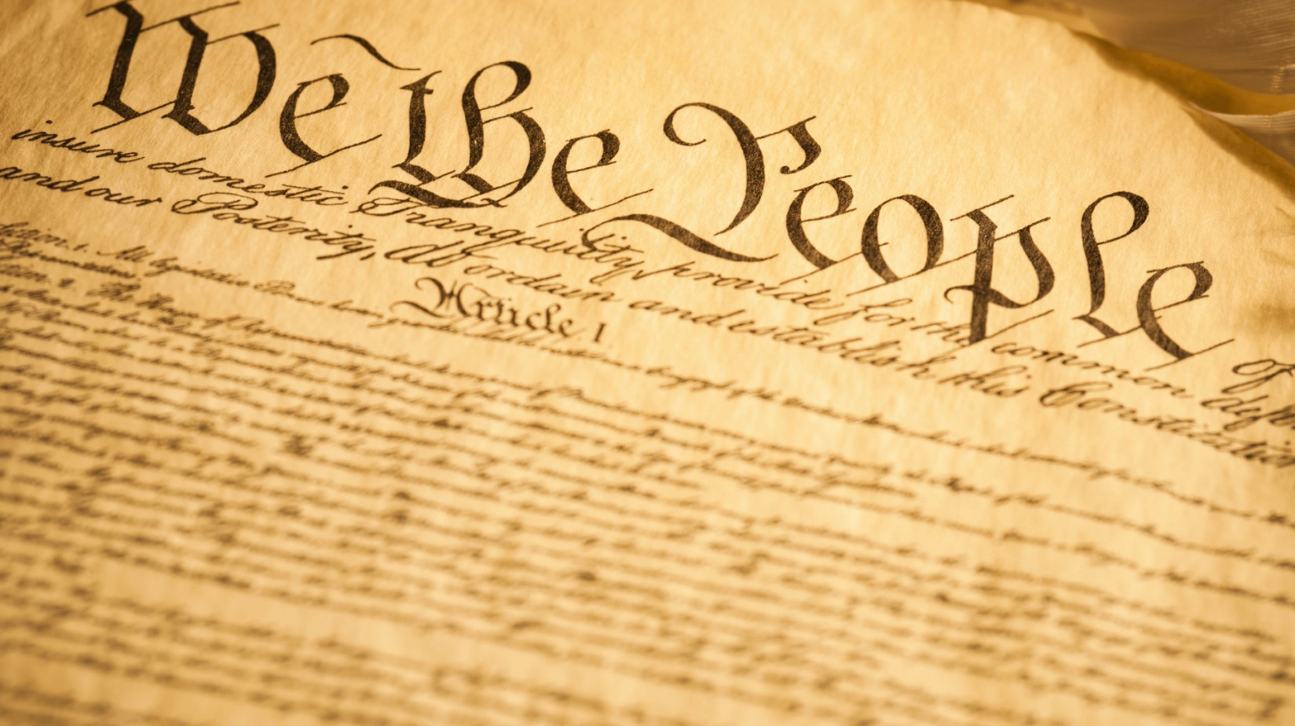
The First Amendment to the Constitution
Congress shall make no law respecting an establishment of religion, or prohibiting the free exercise thereof; or abridging the freedom of speech, or of the press; or the right of the people peaceably to assemble, and to petition the Government for a redress of grievances
This Photo by Unknown Author is licensed under CC BY

Slide 19
The First Amendment to the Constitution
Free speech does not mean that every US citizen has the legal right to say anything at any time
If speech is likely to lead to violence or other illegal acts it is not protected

Slide 20
Mass Communication and Ethics
Media interests and ownership have become more concentrated over the past few decades
The merger of media companies was meant to provide synergy that could lower costs and produce higher profit
Media Convergence is the merging of technologies that were previously developed and used separately – such as TV and Internet

Slide 21
Media and Globalization
Globalization is the interconnecting of structural and cultural forces that aid the spread of ideas and technologies and influence the social and economic organizations of societies.
Media Imperialism is the domination of other countries through exported media and the values and ideologies they contain

Slide 22

Media and Globalization
Media fueled cultural imperialism is critiqued because of the concern that the imported cultural images and values will end up destroying or changing the cultural identities of the countries being occupied by this new media
This Photo by Unknown Author is licensed under CC BY-SA

Slide 23
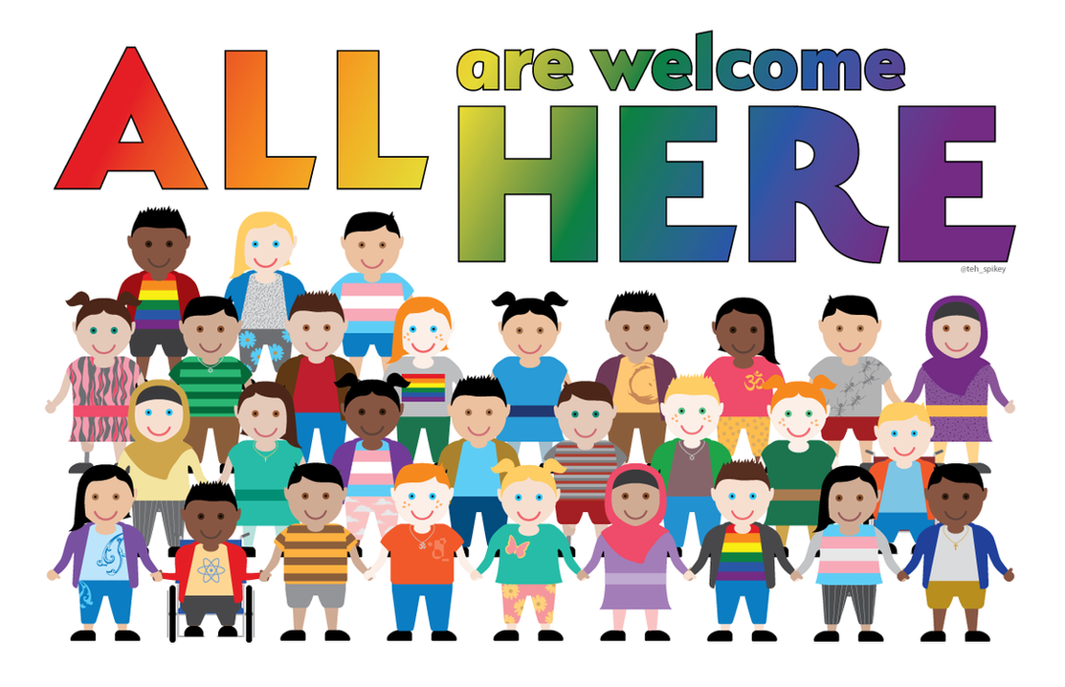
Media and Representation
The lack of representation of diversity in media messages
Social Learning Theory claims that media portrayals influence our development of schemata or scripts, especially as children, about different groups of people
This Photo by Unknown Author is licensed under CC BY-NC-ND

Slide 24
Developing Media Literacy
Media Literacy is our ability to critique and analyze the potential impact of the media
Our ability to read media messages and critically think and listen
Media literacy is reflective in that we are asked to be accountable for those choices we make in regards to media by reflecting on and being prepared to articulate how those choices fit in with our own values and beliefs

