Slide 1
Chapter 3
Audience Analysis

Slide 2
What is Audience Analysis
The process of gathering information about the people in your audience so that you can understand their needs, expectations, beliefs, values, attitudes, and likely opinions.

Slide 3
Why Conduct Audience Analysis?
Allows to choose a worthwhile topic- noble, interesting, relevant.
Informs about audience disposition toward controversial topics
Allows to adapt your speech to audience needs
Informs about audience diversity
Helps to avoid offensive remarks
Ethical language choices:
Be accurate
Be aware of emotional impact
avoid hateful words
be sensitive to the audience
Allows to deliver ethical speech: ethos (credibility)

Slide 4
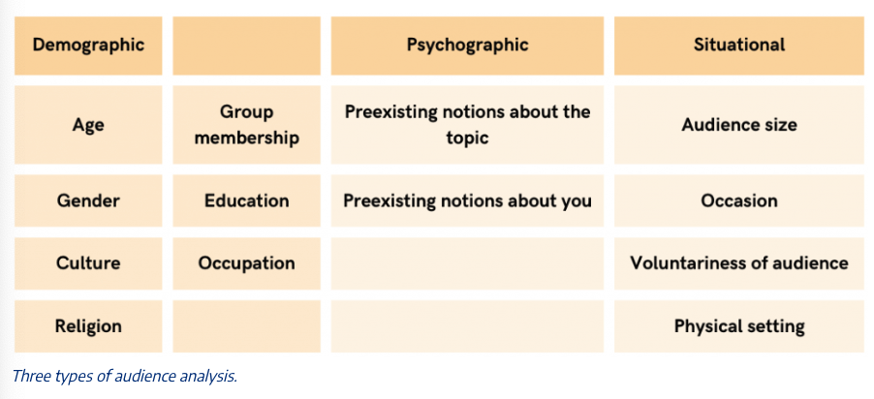
Three types of Audience Analysis

Slide 5
Conducting Audience Analysis
Direct observation
Interviews and surveys
Form questions that are directly related to your speech topic
create and use a standard set of questions
keep interviews and surveys short
Don’t rely on just a few respondents.
Focus groups
Existing data about your audience

Slide 6
Using Your Audience Analysis
Before speech
Prepare content with your audience in mind
be clear with your message
During speech
make adjustments during the actual speech: use humor, raise your voice, pose questions, etc.

