Slide 1
Chapter 1
Why Public Speaking Matters Today

Slide 2
Public Speaking in the 21st Century
Public speaking is the process of designing and delivering a message to an audience
Important to understand your audience and the speaking goals

Slide 3
Public Speaking in the 21st Century
Public speaking continues to be relevant even with the growth of more technology to communicate
Many of us communicate to the public through social media
This Photo by Unknown Author is licensed under CC BY-NC-ND

Slide 4
Why is Public Speaking Important?
We are exposed to hundreds even thousands of messages every day
The amount of knowledge in the world doubles every 12 hours
Because we have access to so much information, being able to communicate information in a way that is accessible to everyone is a critical skill

Slide 5
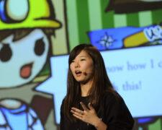
Informative Speaking
The most common form of public speaking
Primary purpose is to share knowledge of a subject
To teach the audience for the purpose of expanding their knowledge
Used often professionally often
This Photo by Unknown Author is licensed under CC BY

Slide 6
Persuasive Speaking
The second common form of speaking
Used to convince, motivate or call to action the audience
Supporting a side of an argument and advocating for that side
This Photo by Unknown Author is licensed under CC BY-SA-NC

Slide 7
Entertaining Speaking
Used in ceremonies
A wide array of speeches from toasts to award presentations
Requires as much practice as Informing and Persuading

Slide 8
Personal Benefits of Public Speaking
Developing critical thinking skills
Fine tuning verbal and nonverbal skills
Overcoming fear of public speaking

Slide 9
Developing Critical Thinking Skills
Problem solving will help in preparing a persuasive speech, when you approach the persuasion by figuring out what the problem is
Enhance ability to conduct and analyze research required to support your ideas
Determining the most important information to share about a topic

Slide 10
Fine Tuning Verbal and Nonverbal Skills
Actively practice verbal skills and receive feedback
Feedback on nonverbal actions that may distract from the speaker
A built in speech coach

Slide 11
Overcoming the Fear of Public Speaking
Fear of public speaking can be overcome by practicing and engaging in public speaking
Learn specific strategies for overcoming the challenges of speech anxiety

Slide 12
Professional Benefits of Public Speaking
Influencing the world around you
Developing leadership skills
Becoming a thought leader

Slide 13
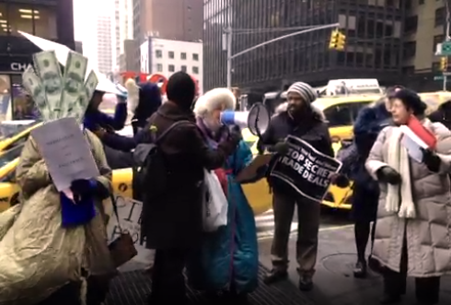
Influencing the World Around You
Exercising our First Amendment rights to speak out
A fundamental right in our democracy and the ability to influence the world
This Photo by Unknown Author is licensed under CC BY-SA-NC

Slide 14
Developing Leadership Skills
If you want people to follow you, you have to communicate effectively
Communication skills can inspire change around you
This Photo by Unknown Author is licensed under CC BY-SA

Slide 15
Becoming a Thought Leader
Individuals who contribute new ideas to the world of business
A thought leader is an influencer who offers guidance and inspires innovation

Slide 16
The Process of Communication
To get your message to be hears, depends on:
The message
The skills of the speaker
The passion of the speaker
The models of communication will help explain the communication process and some challenges faced by speakers

Slide 17
Linear Model of Communication
The original model of communication
The source is the sender of the message
The receiver is the person the message is sent too
Much like in a speech where the source is the speaker, the receiver is the audience and the message is the content of the speech

Slide 18
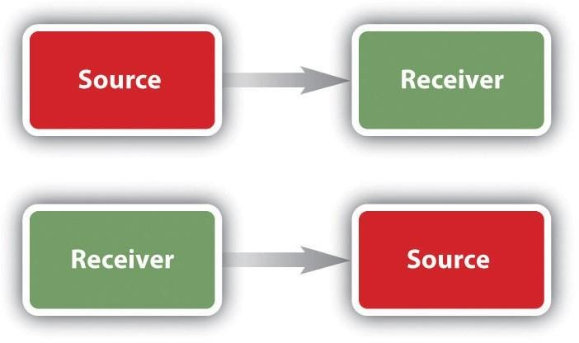
Interactional Model of Communication
Building on the linear model but including the process of encoding and decoding
Encoding is the process of creating a message and adapting it to the receiver
Decoding is the process of interpreting the message and responding to the message

Slide 19
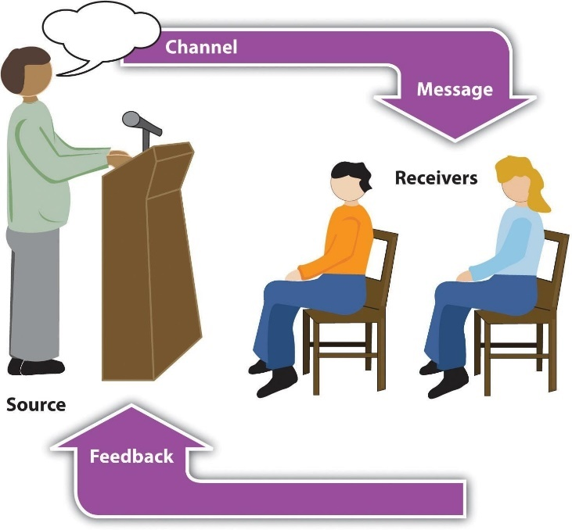
Transactional Model of Communication
Individuals are sending and receiving messages at the same time
Meaning is created by both people interacting together
For meaning to occur we must have shared experiences

Slide 20
Dialogical Theory of Public Speaking
Dialogue is more natural than monologue
Meanings are in people not the words
Context and Social situations impact perceived meaning
This Photo by Unknown Author is licensed under CC BY-SA-NC

Slide 21
Dialogue vs Monologue
Communication should be a dialogue
Dialogue is a conversation
Monologue is one person speaking
When we engage in public speaking we are creating a dialogue with our audience who interact nonverbally

Slide 22
Meanings Are In People, Not Words
The meaning of words must be mutually agreed upon by people interacting with each other
To be successful in conveying our desired meaning, we must know our audience and make language choices that will convey the most appropriate meaning in that context

Slide 23
Contexts and Social Situations
Physical Dimensions – the environment that the speech is occurring in
Temporal Dimensions – the time of day and moment in time that the speech occurs in
Social-Psychological Dimensions – the relationship between the speaker and the audience
Cultural Dimensions – The cultural beliefs and norms of the speaker and audience

